Slide 1
Abstract classes
It is a process of displaying the required details of the program to the users and not showing how the internal programming is done is called abstraction.
This abstraction is achieved by abstract classes and interfaces

Slide 2
Rules for abstract class
Abstract method must not be defined it should be declared
If at least one abstract method is present in a class then entire class becomes abstract class.
Extended class must define the abstract method or else that class also become abstract class.

Slide 3
Example of abstract class
abstract class Bike{
abstract void run();
}
class Honda4 extends Bike{
void run(){System.out.println("running safely..");}
public static void main(String args[]){
Bike obj = new Honda4();
obj.run();
}
}

Slide 4
Interface
If in a class all the methods are abstract methods then it is called interface
Java doesn’t support multiple inheritance so using interface we can do it.
Interface uses implements keyword instead of extends as in classes.
Interface can improve security of the code

Slide 5
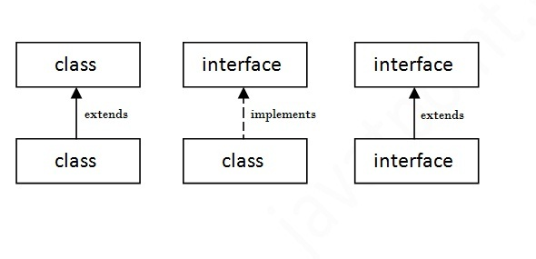
Relation btw classes &interfaces
If there are multiple interfaces then to define the methods we should call the interface using implements keyword
Interface B{ Void run(); }
Interface C{ Void walk(); }
Class A implements B,C{
Void run(){syso(“he is running”);
Void walk(){syso(“he is walking”)
}

Slide 6
Examples of Interface
interface printable{
void print();
}
class A6 implements printable{
public void print(){System.out.println("Hello");}
public static void main(String args[]){
A6 obj = new A6();
obj.print();
}
}

